Slide 1
Student Records
C project: file-based student record management

Slide 2
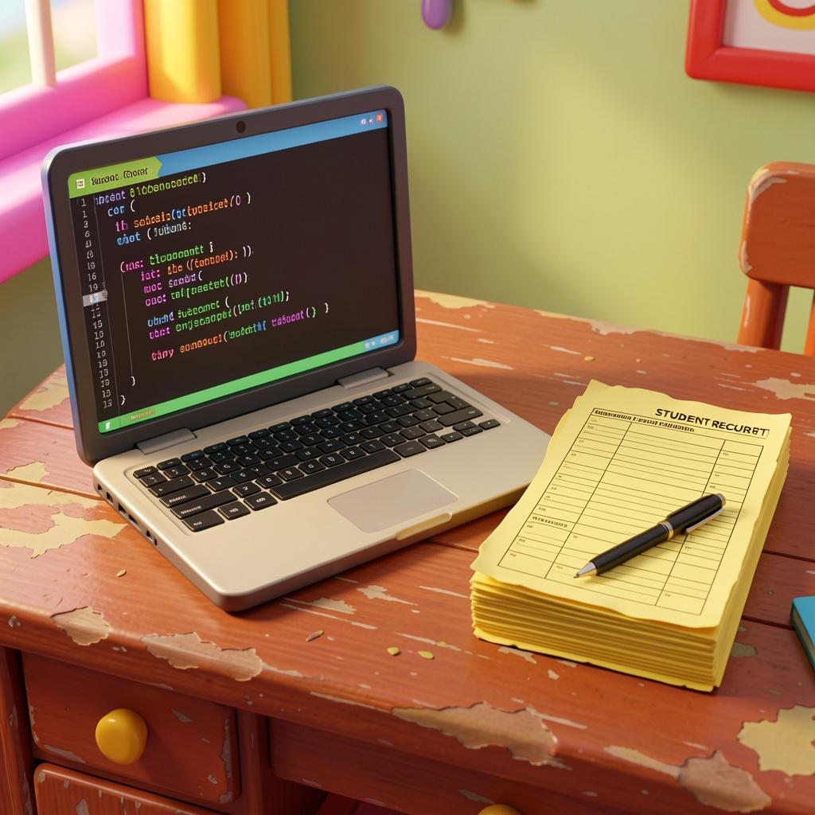
Introduction
A simple Student Record Management System written in C using file handling to store and retrieve student data.
Automates manual tasks for faster, error‑reduced record keeping and easy data access.

Slide 3

01
Overview

Slide 4
Abstract summary
A lightweight system that stores student details in students.txt, supports add, view, update, and delete operations.
Uses structures and file handling to persist records and retrieve them reliably.

Slide 5
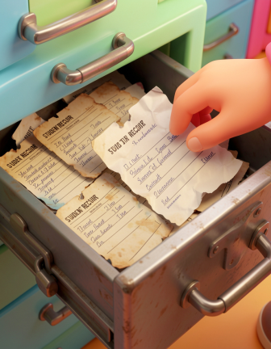
Problem statement
Manual record keeping is slow, error-prone, and hard to search.
This project provides an automated, console-based solution for straightforward student data management.

Slide 6
Key conclusion
A compact Student Record Management tool in C that automates manual record tasks.
Reliable file-based storage and basic CRUD operations make it suitable for beginners and small-scale use.

Slide 7
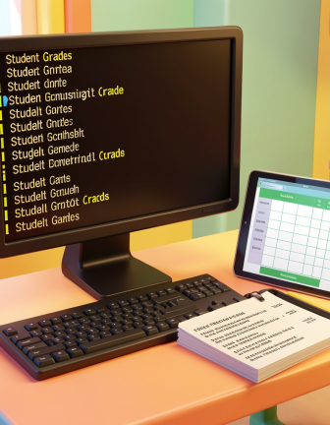
02
Implementation

Slide 8
Algorithm steps
Start program and display menu options.
Get user choice, perform the selected operation (add/view/update/delete), and persist changes to file.
Loop until user exits.

Slide 9
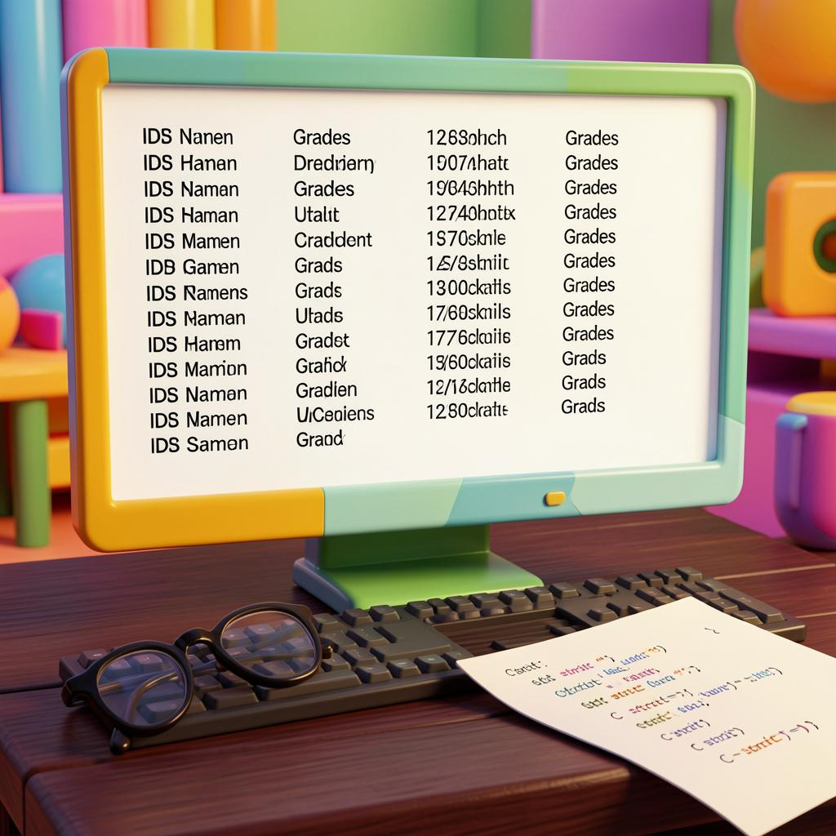
Technical details
Implemented in C using structures to model student data.
File handling with students.txt for persistent storage and simple text parsing for records.
Console-based I/O and linear search for lookups.

Slide 10
Results validation
Records written to students.txt after add/update/delete operations.
Viewing displays parsed records correctly.
Basic manual tests confirm data integrity and expected behavior.

Slide 11
Conclusions
Simple, efficient, and educational: demonstrates structures and file I/O in C.
Ready as a beginner project or classroom example.

Slide 12
Thanks!
Do you have any questions?
youremail@freepik.com
+34 654 321 432
yourwebsite.com
Please keep this slide for attribution

